Slide 1
My favorite gifts

Slide 3
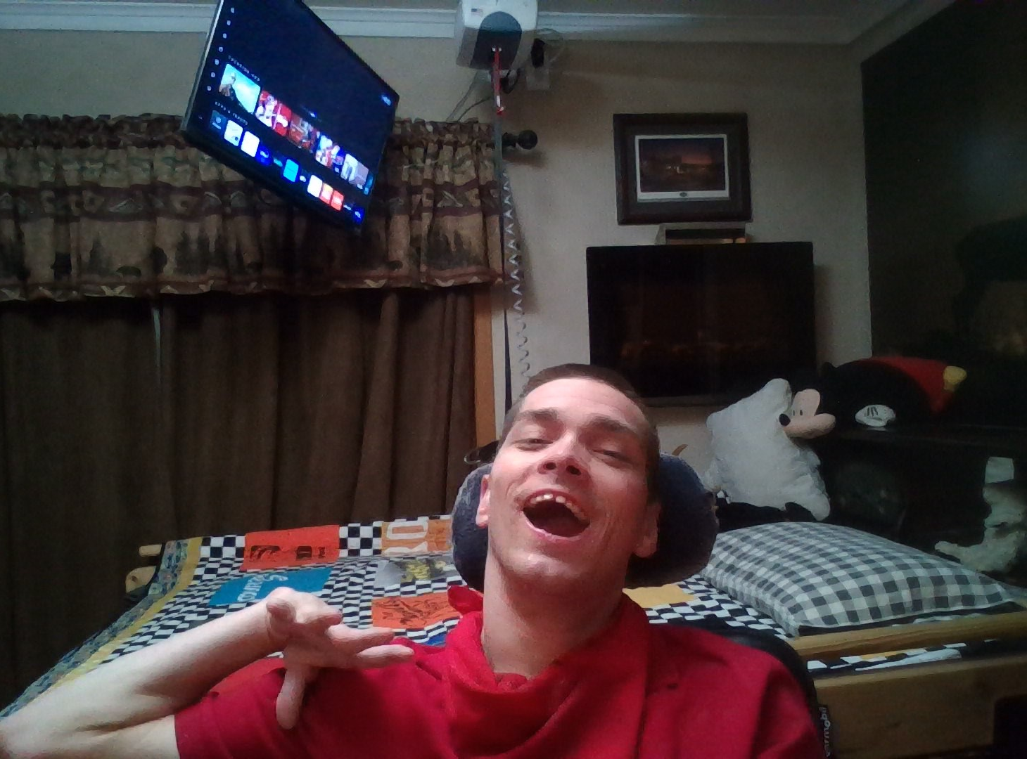

Slide 4
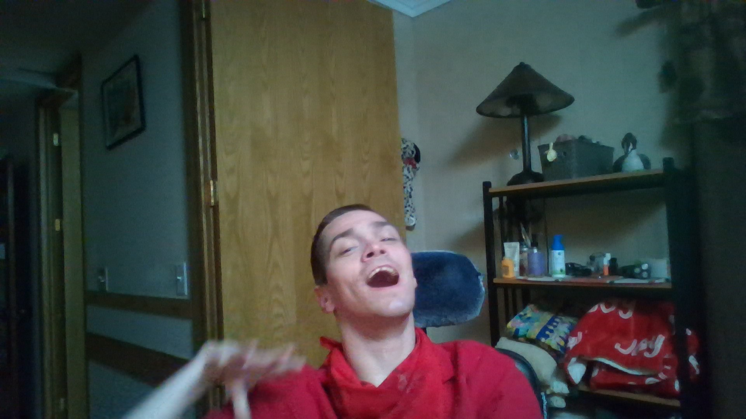

Slide 5
